Slide 1

PUNJAB SAFE CITIES
Proof of Concept (POC)
2021. 11. 23

Slide 2
CONTENTS
01.
Introduction
02.
POC Features
03.
Graphical User Interface
04.
Future Integrations
05.
Questions

Slide 3
INTRODUCTION
What is Safe Cities Concept?
Safe cities vision is to make an Integrated Command, Control and Communication Program (IC3) which gathers and disseminates data and information with various sources for example government offices, executives of traffic management, intelligence agencies and other private and public entities.
Moreover it helps government to monitor and control the facilities provided to the people and also make people feel safe and comfortable.

Slide 4
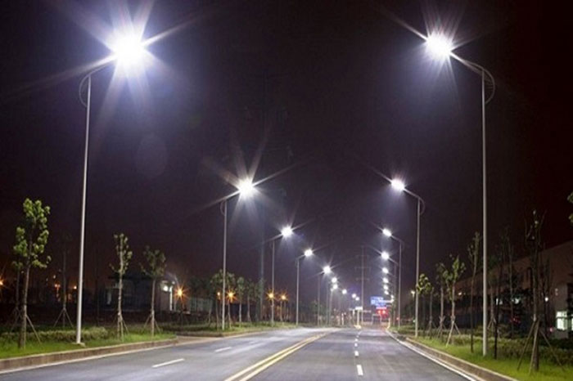


POC FEATURES
FOLLOWING ARE THE FEATURES OF THIS POC
STREET LIGHT MONITORING
STREET LIGHT CONTROLLING

Slide 5
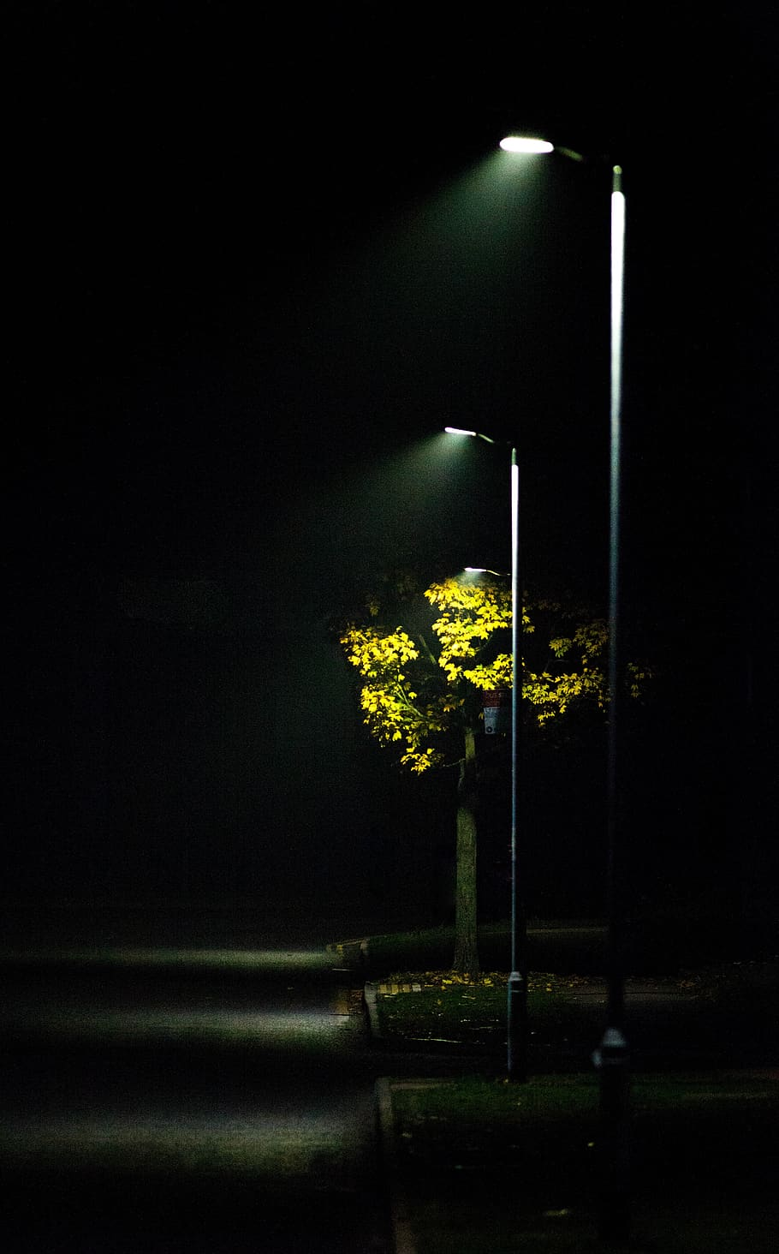
POC FEATURES
Remote Controlling
2 Street Lights will be controlled
Both street lights will be controlled individually
A switch will be used to control each street light on the Graphical Interface.
Street Lights Controlling
Remote Monitoring
2 Street Lights will be monitored
Both street lights will be monitored individually
A Graphical Interface will be used to monitor the state of each street light.
Street Lights Monitoring

Slide 6
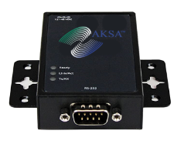
HARDWARE SPECIFICATIONS
Remote Monitoring Gateway

Slide 7
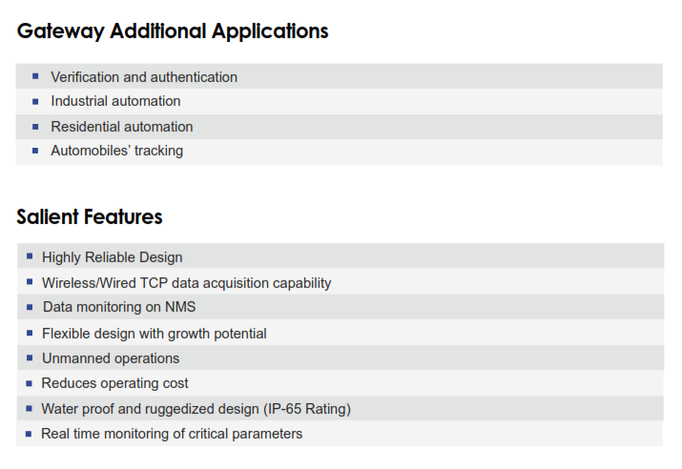

Slide 8
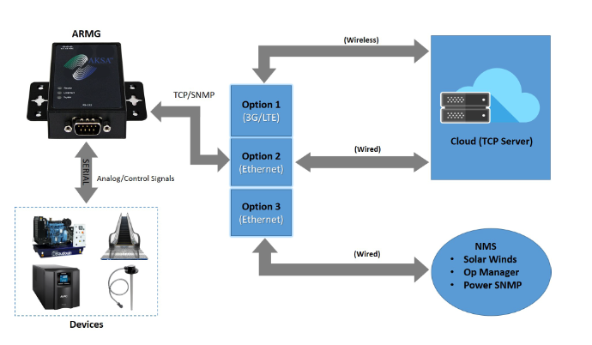
Functional Diagram

Slide 9
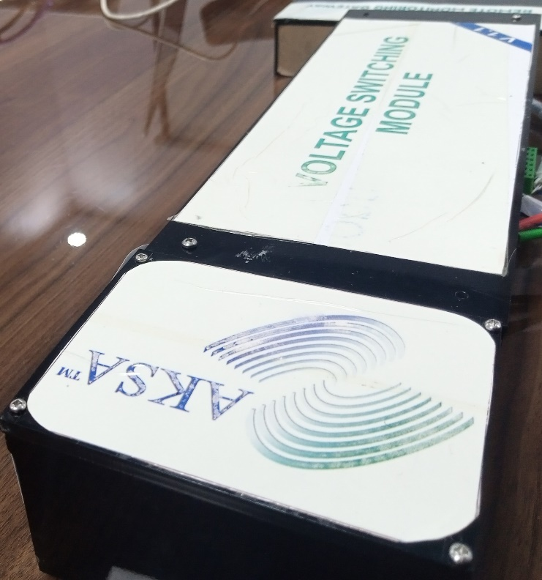
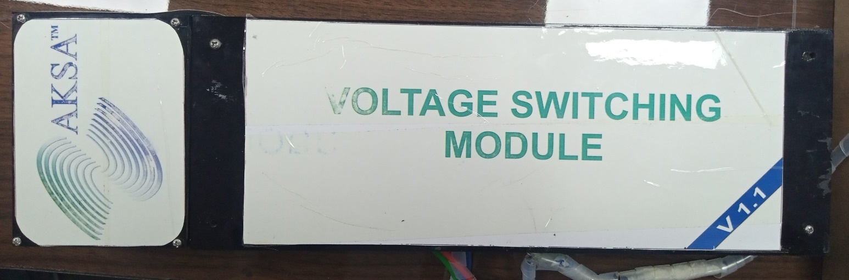
HARDWARE SPECIFICATIONS
Voltage Switching Module
This box contains all the necessary hardware for the street lights monitoring purpose. Also the AC relays for switching of the street lights are incorporated in it.

Slide 10
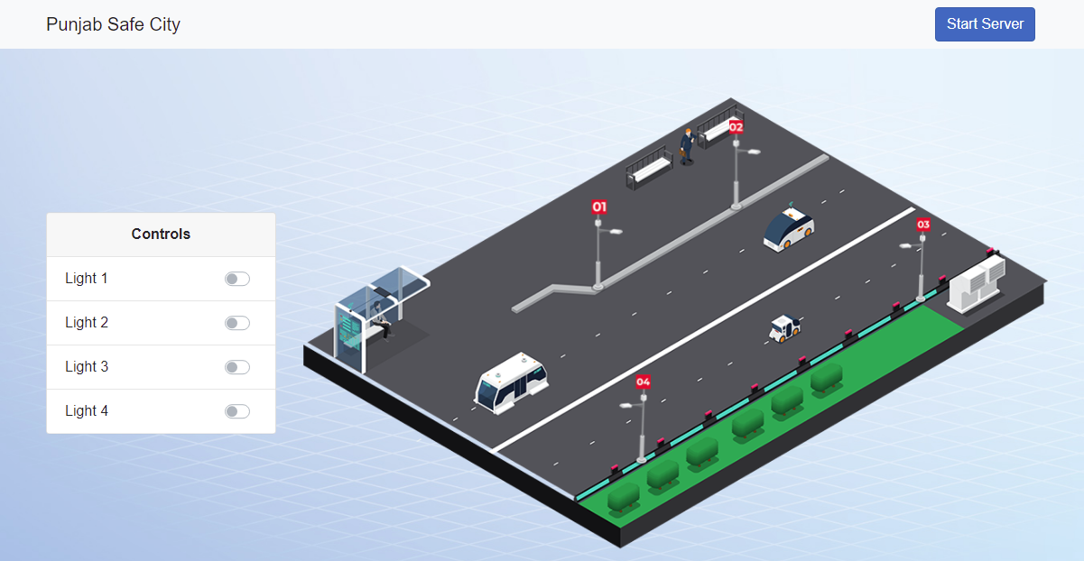

Graphical User Interface
A Graphical User Interface (GUI) will be available for the staff to monitor and control the street lights remotely from the control room.

Slide 11





FUTURE INTEGRATIONS
Following features could be integrated into the project
SCHEDULED SWITCHING
WEATHER STATIONS
SECURITY CAMERAS
TRAFFIC MANAGEMENT
Street Lights will be switched ON and OFF at Dawn and Sunset respectively.
Real-time temperature, humidity, fog, light intensity etc. will be monitored.
Crimes will be monitored using CCTV cameras
Traffic will be monitored and managed remotely
SMART ENERGY SYSTEM
SMART ENVIRONMENT SYSTEM
Solar panels will be installed with the street lights
Environmental gases will be monitored and alerts will be generated.

Slide 12
Questions?

Slide 13
Thanks !
AKSA Solutions Development Services
https://www.aksa-sds.com/

